Slide 1



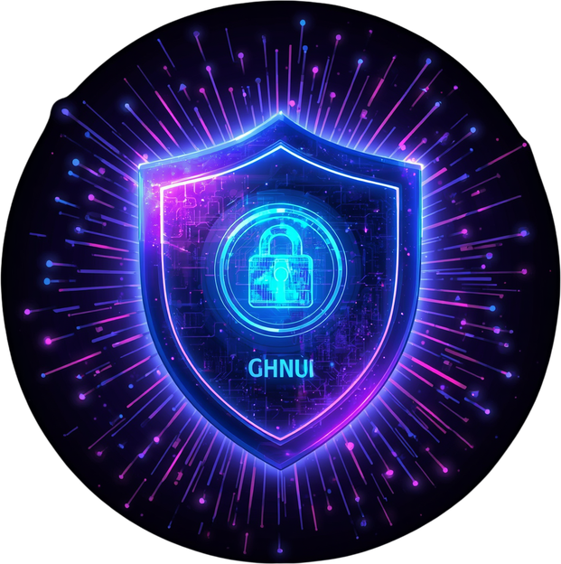
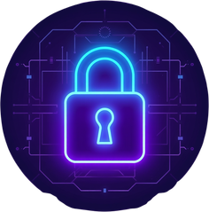

PHISHING
TRACKER
Your Shield Against Online Threats

Slide 2
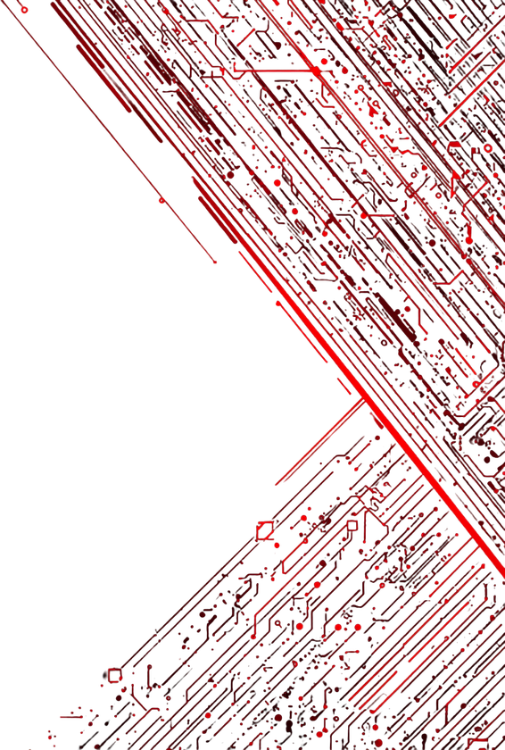


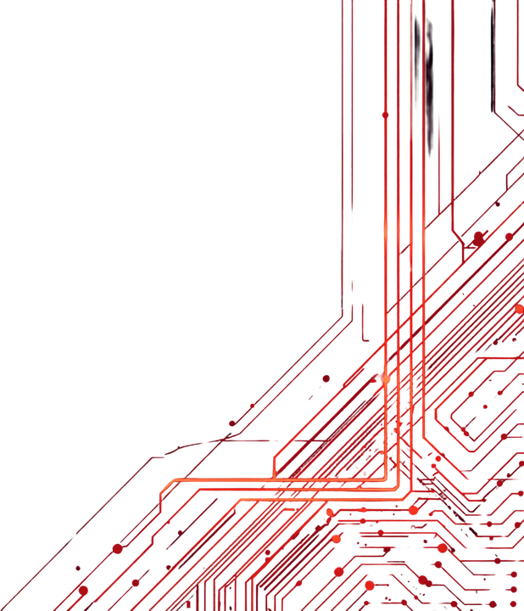
PHISHING TRACKER
THE PROBLEM
1 IN 3 PEOPLE FALL FOR PHISHING
Phishing attacks are escalating at an alarming rate, putting millions at risk every day. Consider these shocking statistics:
• 3.4 billion phishing emails are sent daily worldwide
• $17,700 is lost every minute to phishing scams
• Users struggle to distinguish fake websites from legitimate ones
• 91% of cyberattacks begin with a phishing email
The threat is real, growing, and affects everyone online.
02

Slide 3


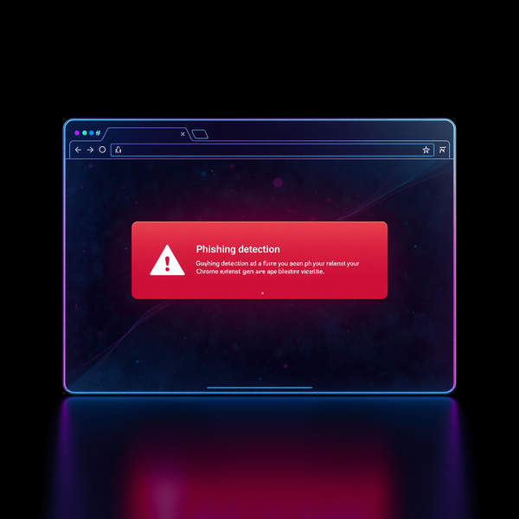
PHISHING TRACKER
03
OUR SOLUTION
Real-time AI-powered phishing detection — right in your browser. Our Chrome extension works silently in the background, analyzing every website you visit and alerting you instantly when threats are detected. A red danger banner overlays suspicious sites, keeping you protected without disrupting your browsing experience.

Slide 4


PHISHING TRACKER
HOW IT
WORKS
ARCHITECTURE
02
01
Website Visit & Detection
03
Risk Score & Alert
User visits any website → Background Service Worker activates instantly → Captures URL and page metadata for analysis.
Concurrent Analysis
Results combine into a unified risk score (0-100) → Color-coded alert banner displays instantly: Green (Safe), Orange (Suspicious), or Red (Dangerous).
Two parallel checks run simultaneously: Google Safe Browsing API queries real threat database + 9-rule heuristic engine analyzes URL patterns locally.
04

Slide 5




PHISHING TRACKER
05
TECH
STACK
TypeScript
Chrome MV3
Google Safe Browsing API
Type-safe development ensuring robust, maintainable code with compile-time error detection.
Built on the latest Manifest V3 extension standard for enhanced security and performance.
Access to Google's real-time threat database containing millions of known phishing URLs.

Slide 6



PHISHING TRACKER
06
HEURISTIC
ENGINE
9 Smart Detection Rules — No Internet Needed
IP address used as domain
Brand name in subdomain (impersonation)
Lookalike characters (e.g., paypa1.com)
Excessive subdomains
Suspicious TLDs (.tk, .ml, .xyz)
Multiple hyphens in domain
Suspicious keywords (login, verify, secure)
Very long domain name
Known phishing domain list

Slide 7

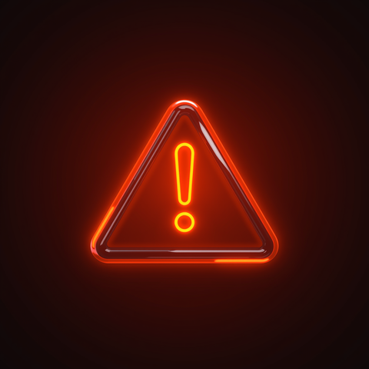

PHISHING TRACKER
07
RISK SCORING
SYSTEM
SAFE (0-25)
SUSPICIOUS (26-55)
DANGEROUS (56-100)
Low risk score indicates a trustworthy website. Green status means you can browse with confidence. No threats detected.
Medium risk score warrants caution. Orange status suggests potential red flags. Proceed carefully and verify the site's legitimacy.
High risk score indicates likely phishing attempt. Red status means immediate danger. Do not enter any personal information.

Slide 8

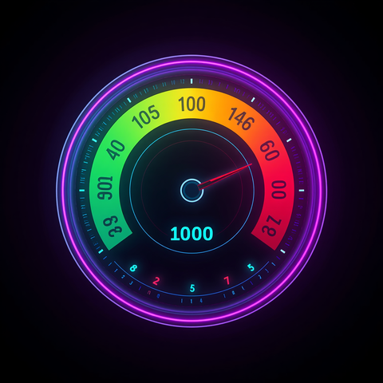
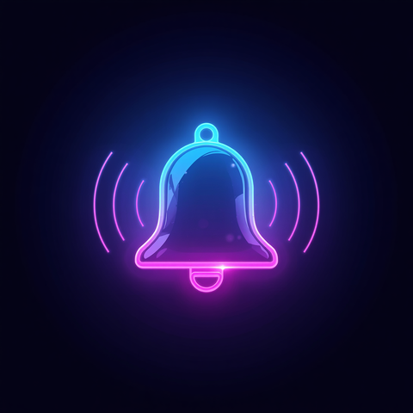
PHISHING TRACKER
08
KEY
FEATURES
🛡 Dual-layer Detection
📊 Risk Score 0-100
🔔 Real-time Alerts
Combines Google Safe Browsing API with our custom 9-rule heuristic engine for maximum protection against phishing threats.
Not just safe or unsafe — get a nuanced risk assessment score that helps you make informed decisions about website trustworthiness.
Color-coded banners appear instantly on every page you visit — green for safe, orange for suspicious, red for dangerous.

Slide 9








PHISHING TRACKER
LIVE DEMO
SEE IT IN ACTION
SAFE SITE
PHISHING ALERT
Green banner displayed on legitimate websites confirming security status.
Red danger banner instantly warns users when visiting detected phishing websites.
09

Slide 10


PHISHING TRACKER
FUTURE
ROADMAP
SCOPE
02
01
03
Community Database
Secure API Key Management
Implement secure server-side API key storage and rotation to enhance security and prevent key exposure in client-side code.
ML Phishing Model
Build a crowdsourced phishing report database allowing users to flag threats, plus expand to Firefox and Safari browsers.
Train and deploy machine learning models for advanced phishing detection, improving accuracy beyond rule-based heuristics.
10

Slide 11


PHISHING TRACKER
THANK
YOU
Stay Safe. Stay Smart.
11

